Slide 1

Capstone project on analysing viability of chipotle stores
Using basic regression model and K-Means clustering

Slide 2
Executive Summary
Background
Problem Definition and Business Case
Technology and stack collection
Data Collection and Pre processing
Model Selection
Execution and Model Tuning

Slide 3
Background
Chipotle is looking to increase its business offshores and is looking at viable offshore location.
Our purpose is to ensure the best value proposition for them by analysing available datasets.
It can help predict the profits that the company would be able to extract by analysing different markets

Slide 4
Problem definition and business case
Chipotel, a Mexican fast food restaurant chain wants to diversify its stores and want to know where this diversification may be profitable. This decision requires clustering of available dataset into certain sets on the basis of the GDP of the state.
We establish a clear relationship between the GDP of a state in the United States of America and the number of restaurants int the state which refers to higher revenues as well
Technology and Stack collection
Python id being used with various libraries including pandas, numpy, matplot and sklean_linear model

Slide 5
Data Collection and pre-processing
The dataset is downloaded from Kaggle(https://www.kaggle.com/jeffreybraun/chipotle-locations) and USA Bureau of Economic Analysis in CSV format . It is a set of unstructured data of scattered locations of chipotle restaurants statewise
Model selection
Simple linear regression model has been used to establish a clear relationship between the GDP and number of chipotle restaurants in a state
K-Means clustering to structure the data and make a broader categorization

Slide 6

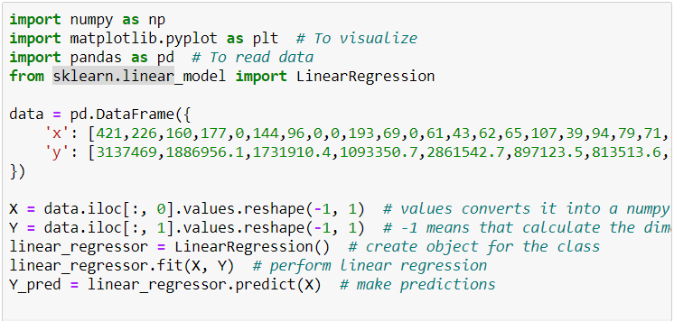
Execution and Model Tuning
We take the data set and import it to a python database using pandas.
Using the imbedded python libraries we develop a line of regression

Slide 7
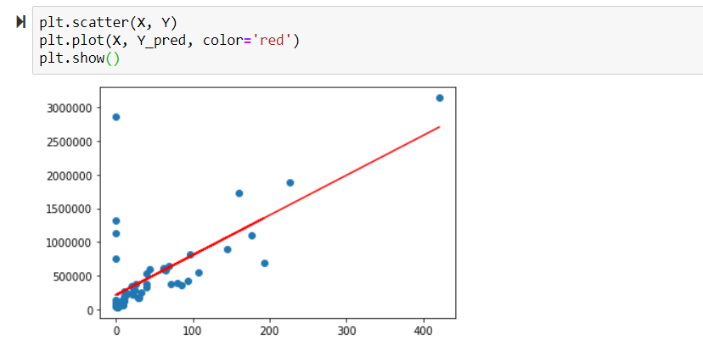
Line of regression
The line of regression established a linear relationship between the GDP of a state(Y axis ) and the number of restaurants (x axis)

Slide 8
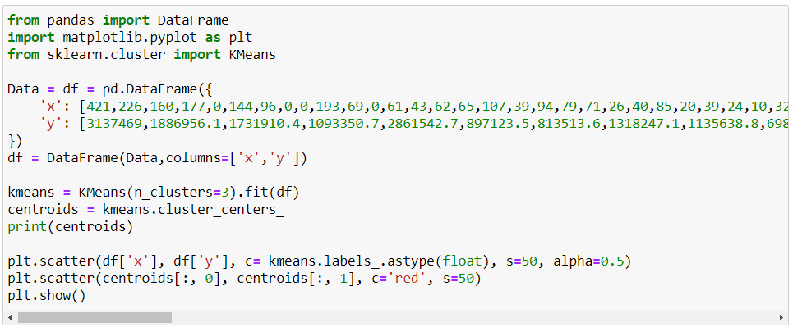
Now we use the embedded libraries to cluster the data into 3 by using K-Means clustering method (K=3 is found using the Elbow and silhouette method)

Slide 9
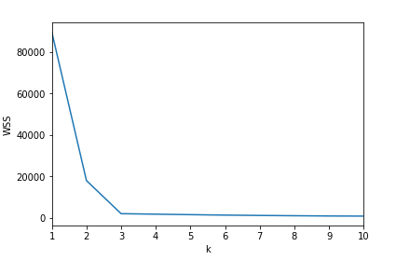
Elbow method to determine value of k

Slide 10
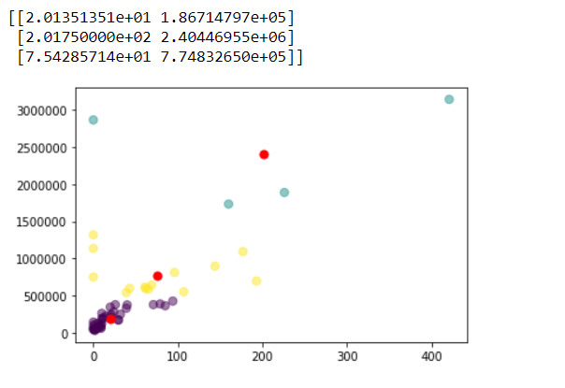
Clustered Data
The above values are that of the centroids represented by the red dots
The three clusters are evident with the colours blue ,purple and yellow

Slide 11

Data Insight
The regression model clearly establishes a linear relationship between the GDP of a state and the number of restaurants in the state
Next the K-Means clustering is used to form 3 clusters of which the first cluster of lower GDP areas prove to be of the most benefit. We can conclude that a country or a state with an overall GDP of less than $500,000

Slide 12
Management Actions
The whole case has divided the present business of the Chipotle stores into 3 major clusters with different GDP values. The company should look at the trend and chose the right location from the shortlisted countries for business expansion
A GDP of almost $500,000 is optimal for setting up new business

Slide 13
Your best quote that reflects your approach… “It’s one small step for man, one giant leap for mankind.”
- Neil Armstrong

